Slide 1
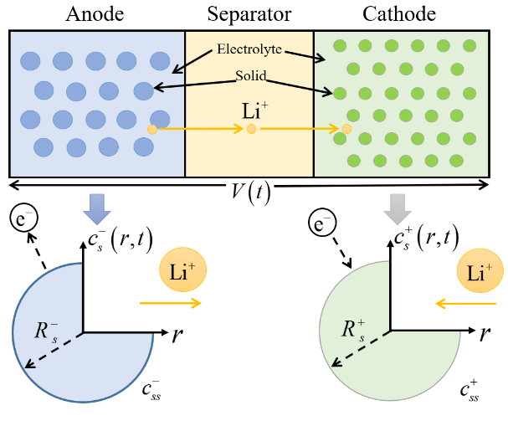
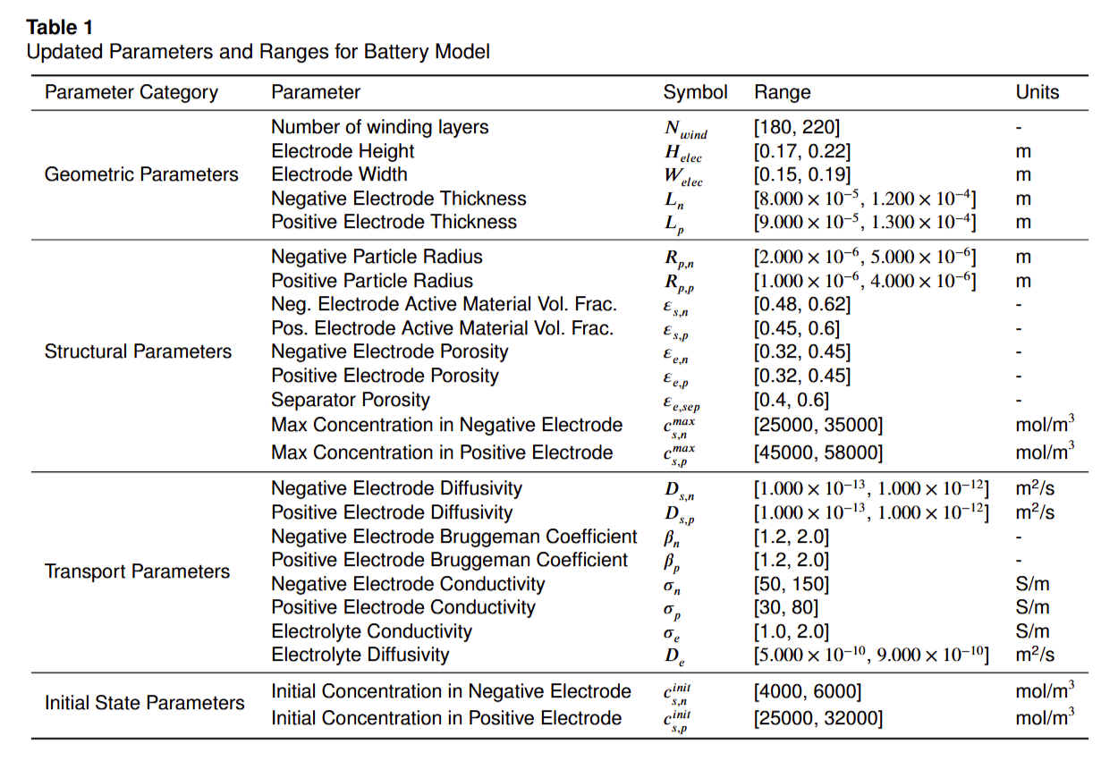
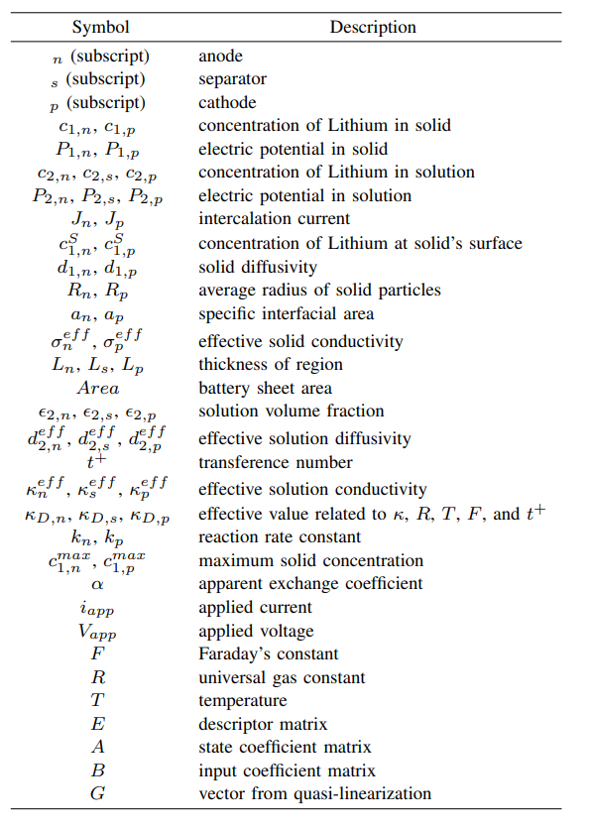
Model Description
Sketch of the DFN concept
Notes:
Theoretical advantages:
High computational efficiency
The algorithm complexity is O (n), requiring only one traversal and simple numerical operations
No need to retrain the model, it can be directly applied to the prediction stage
Compared to sampling methods such as SMOTE, it does not increase training overhead
Good mathematical properties
Maintaining the basic constraint of probability sum of 1
Adaptive adjustment of probability distribution is achieved through threshold mechanism
The design of the amplification factor ensures the rationality of the proportion of probability redistribution

Slide 2
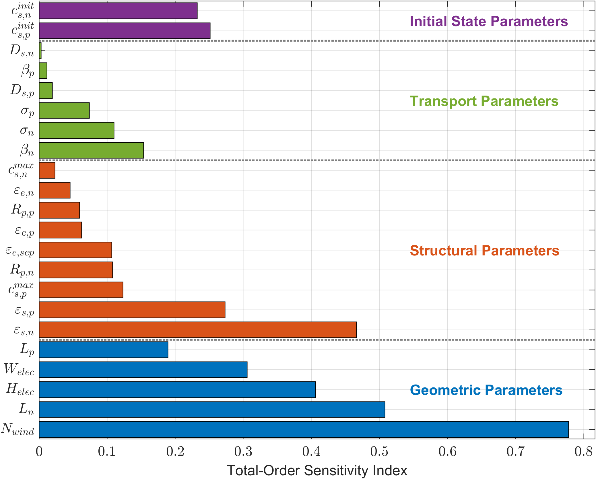
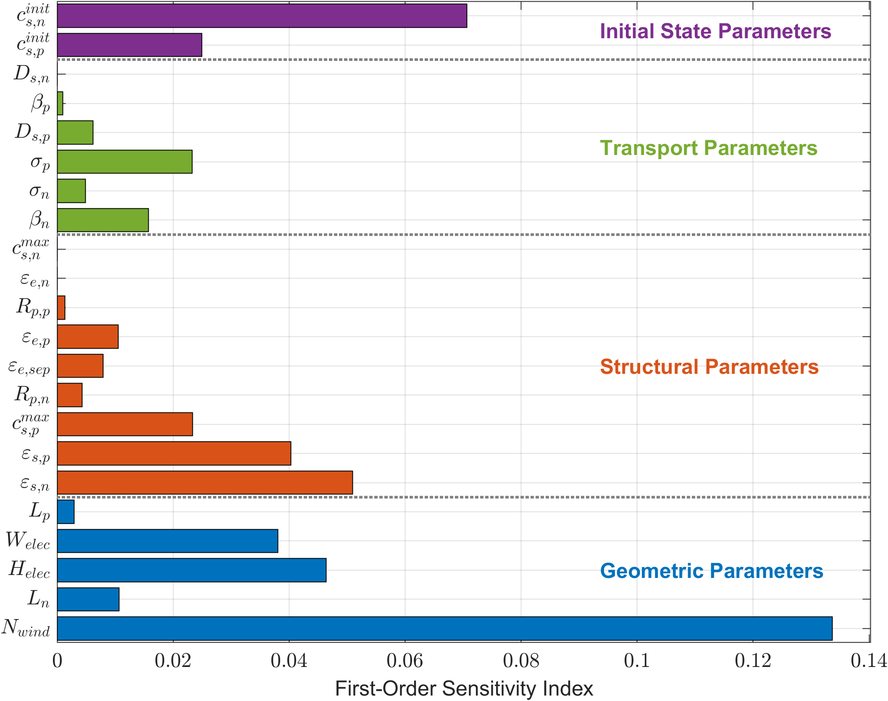
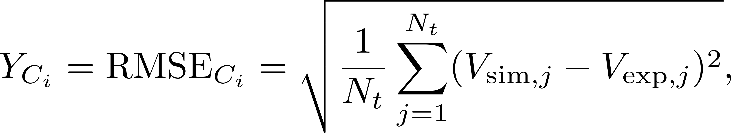
Weighted Global Sensitivity based Parameter Selection
Notes:
Theoretical advantages:
High computational efficiency
The algorithm complexity is O (n), requiring only one traversal and simple numerical operations
No need to retrain the model, it can be directly applied to the prediction stage
Compared to sampling methods such as SMOTE, it does not increase training overhead
Good mathematical properties
Maintaining the basic constraint of probability sum of 1
Adaptive adjustment of probability distribution is achieved through threshold mechanism
The design of the amplification factor ensures the rationality of the proportion of probability redistribution

Slide 3
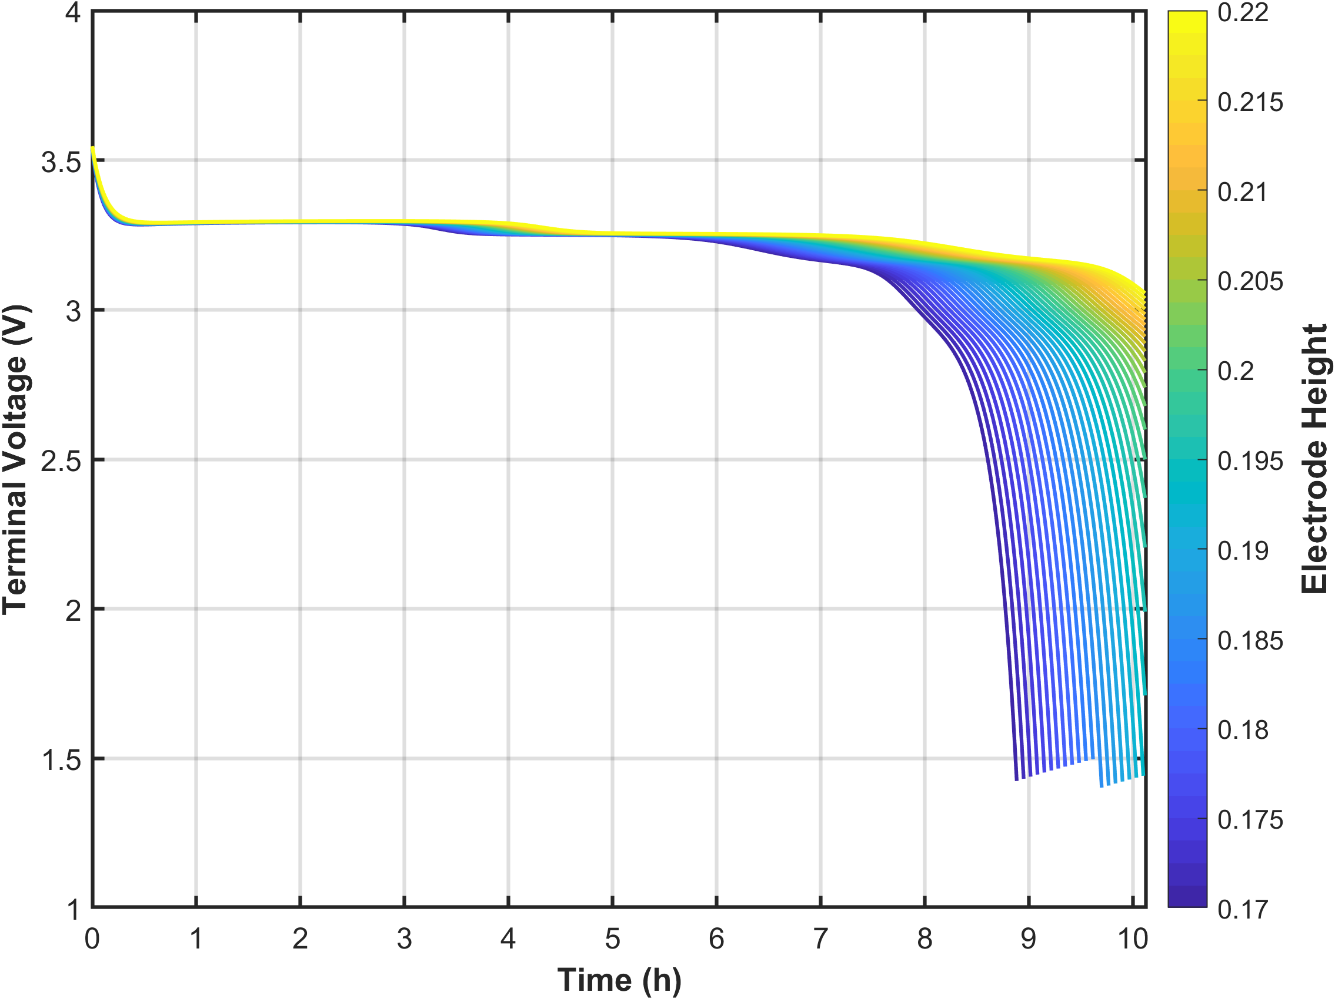
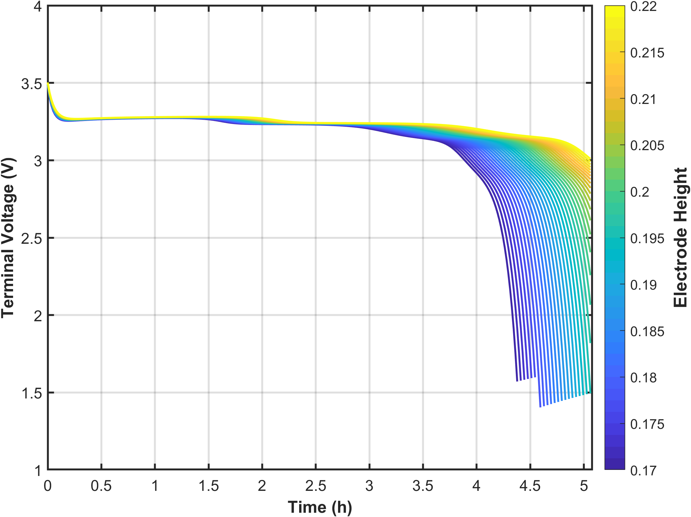
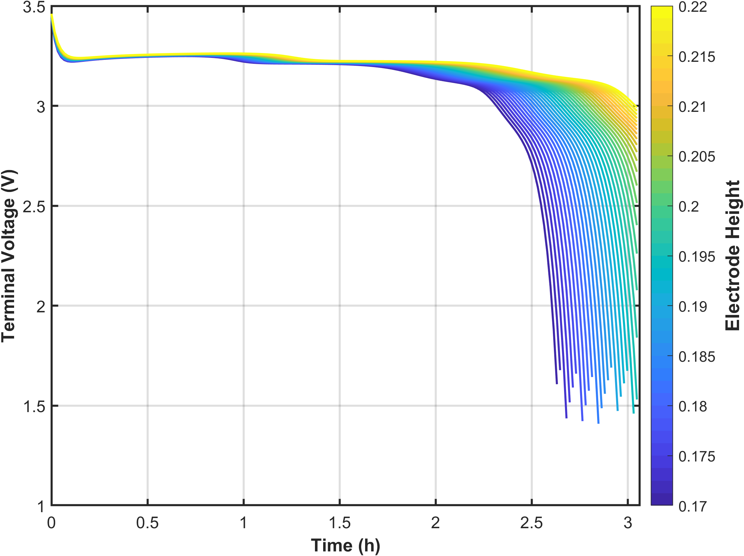
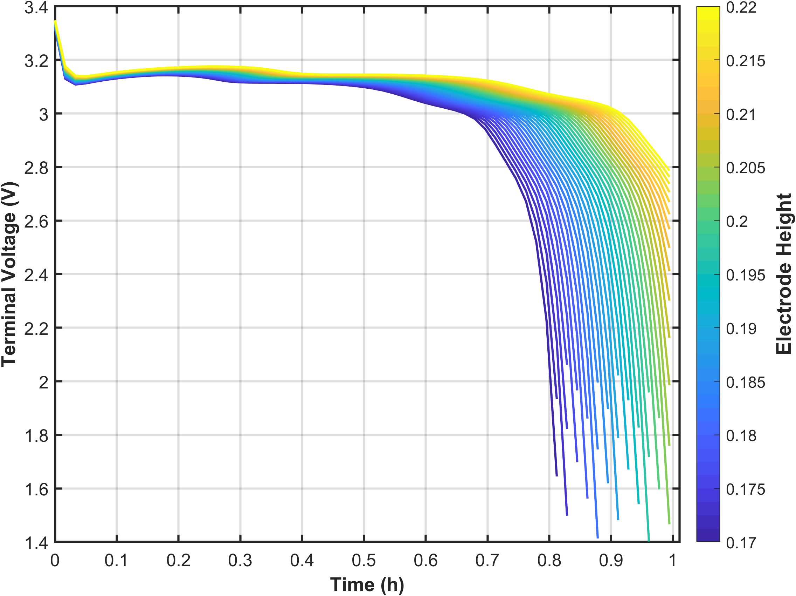
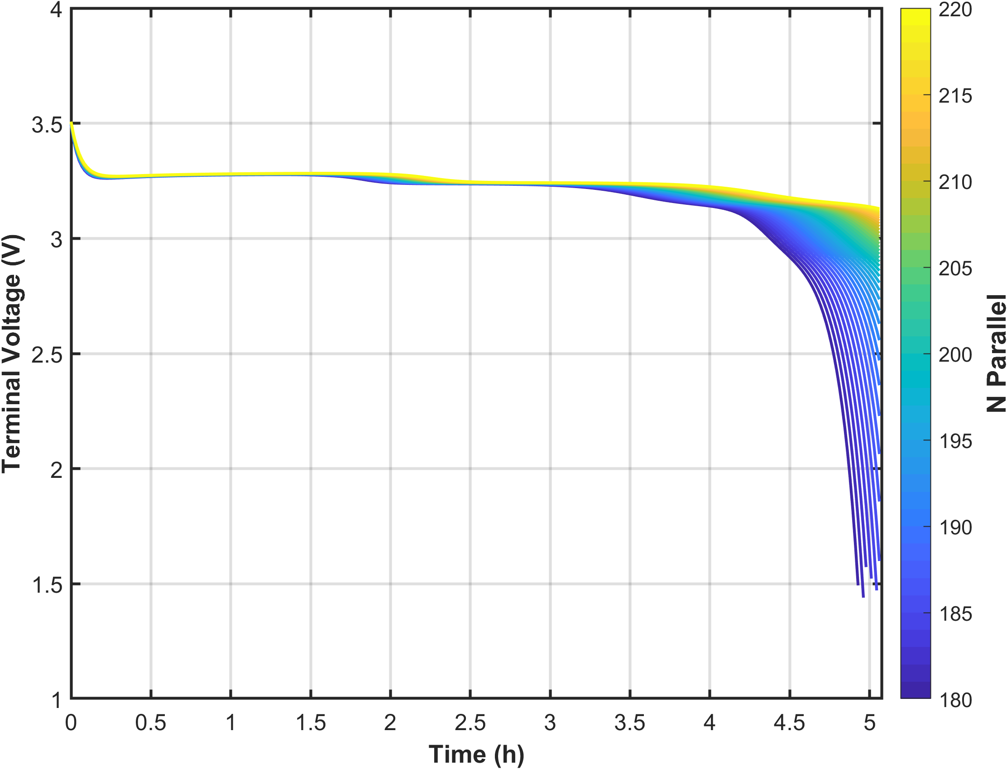
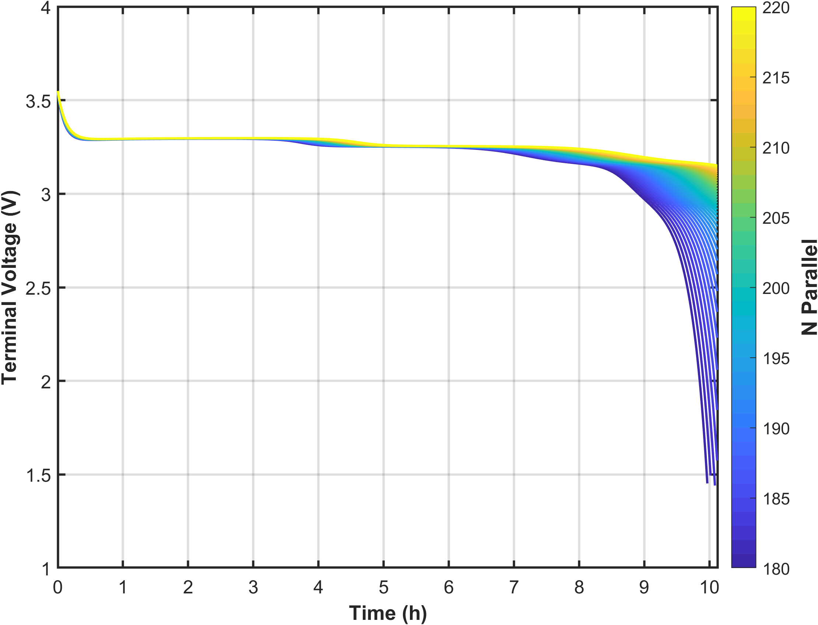
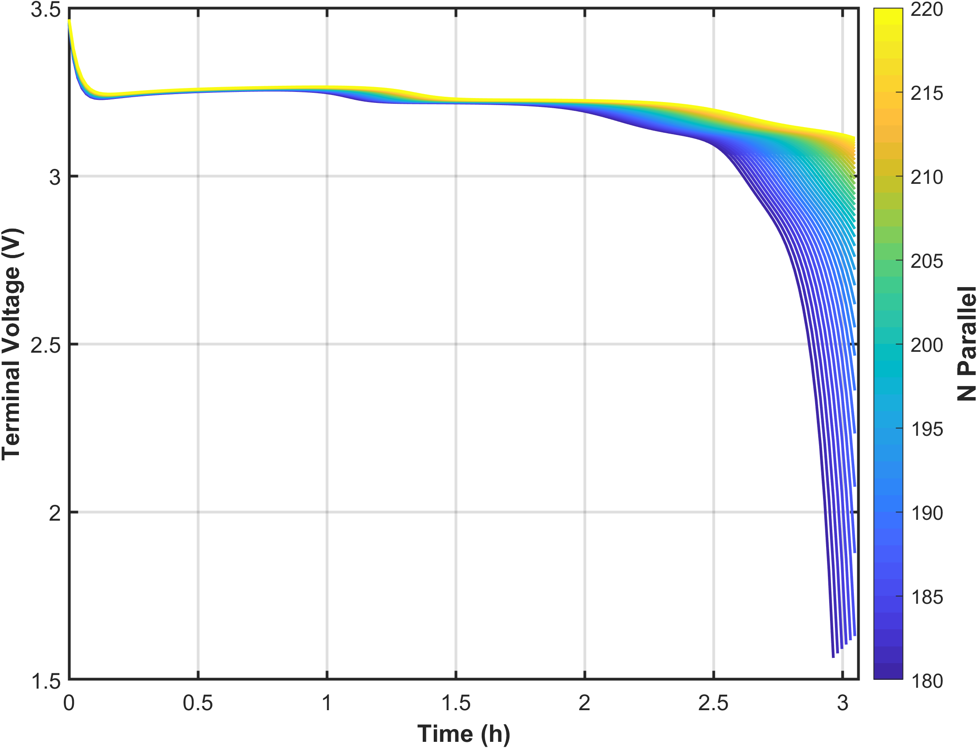
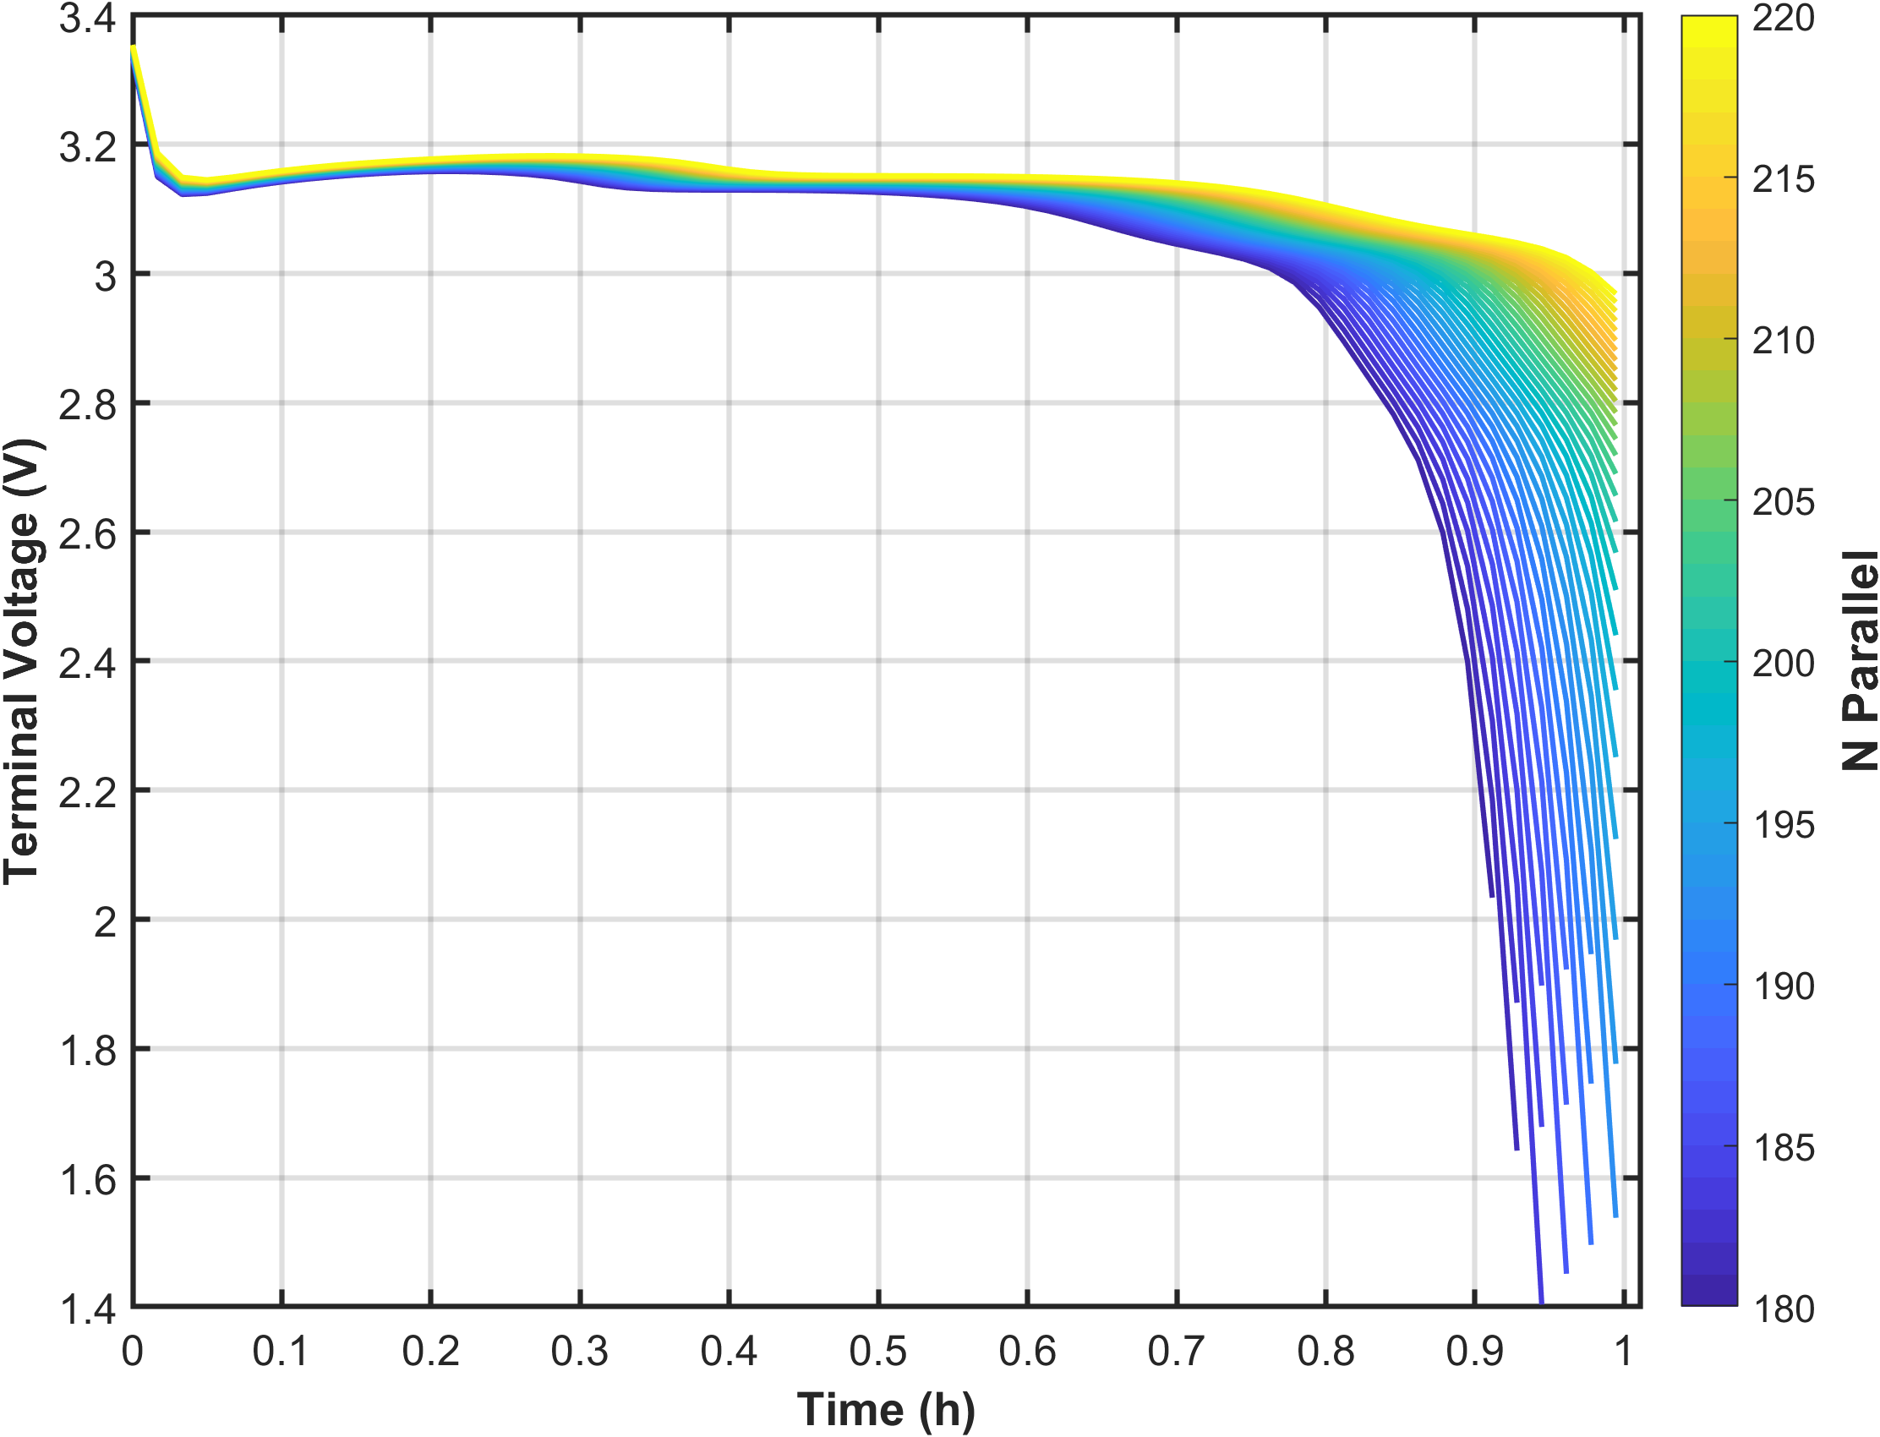
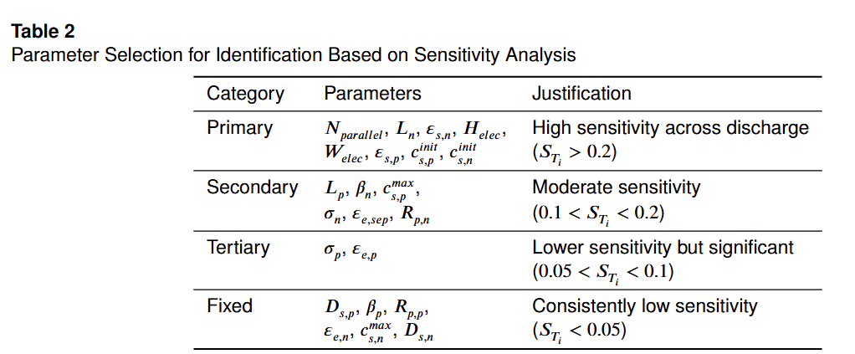
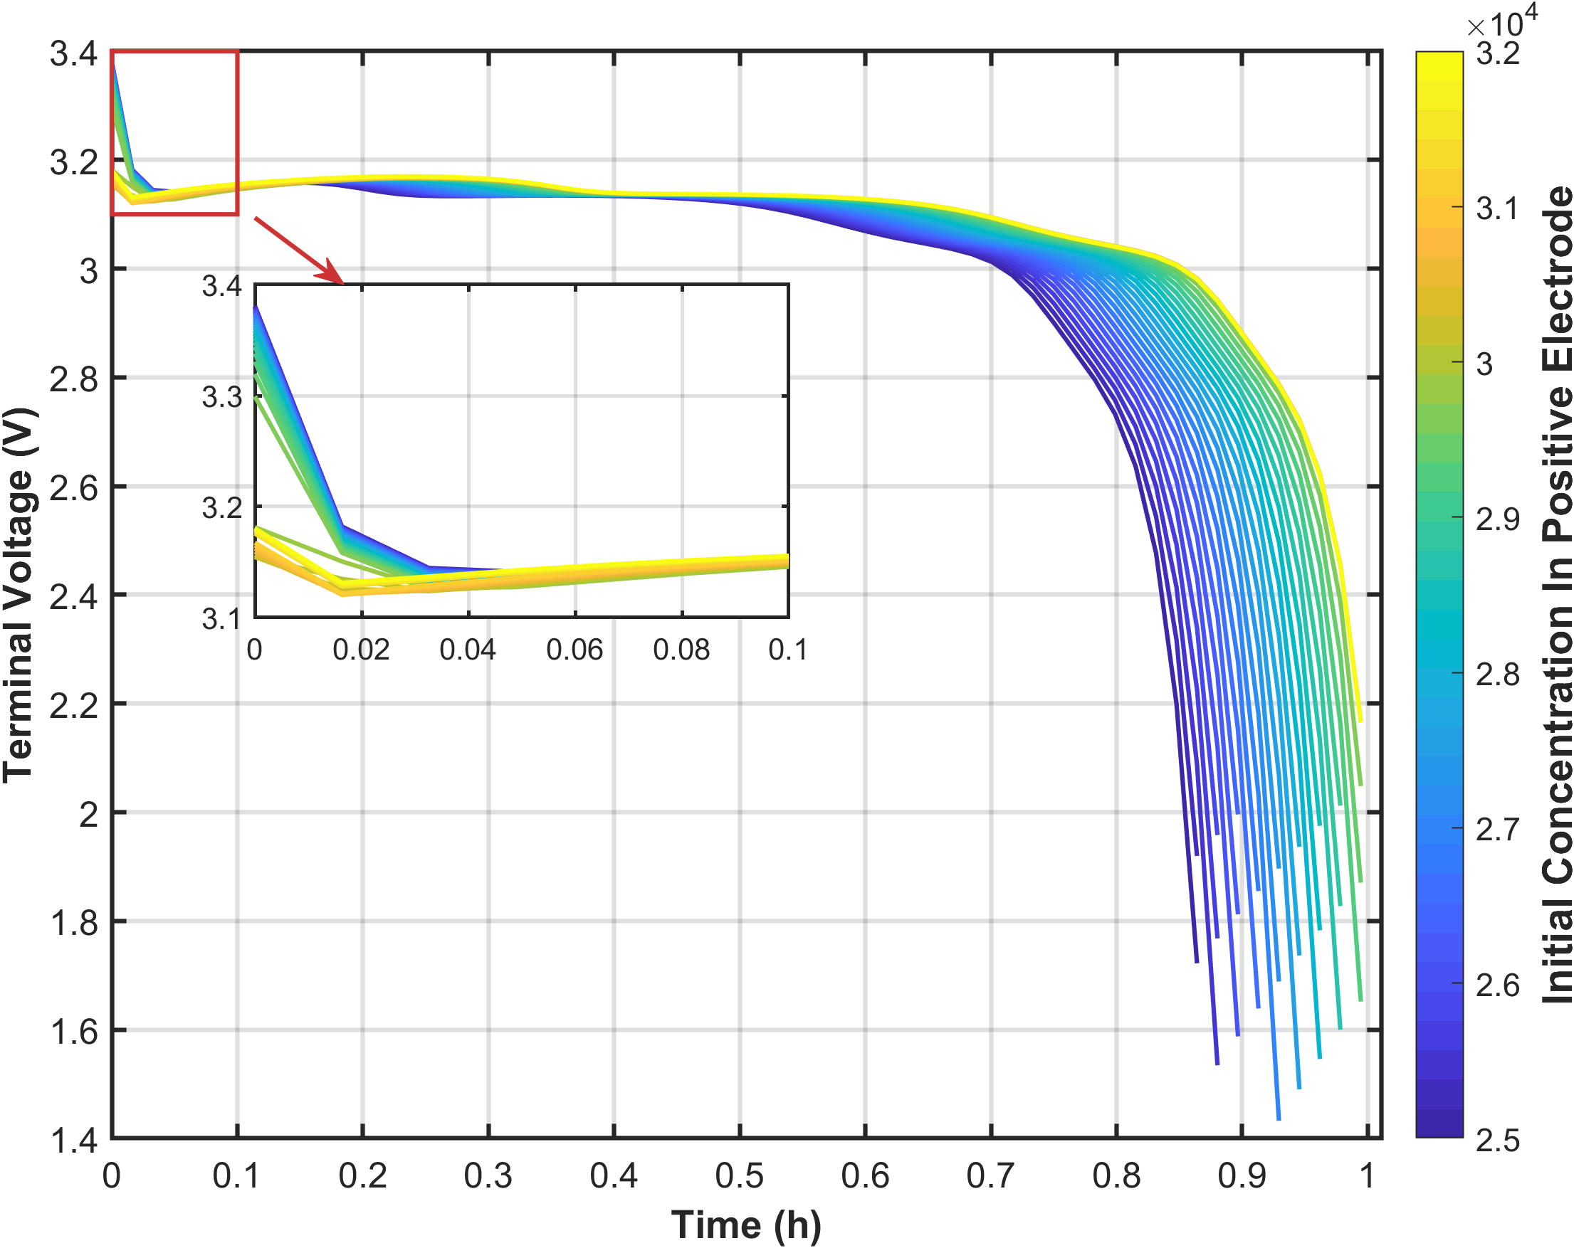
Cross-Condition Sensitivity Analysis
0.1C
0.2C
0.33C
1C
Notes:
Theoretical advantages:
High computational efficiency
The algorithm complexity is O (n), requiring only one traversal and simple numerical operations
No need to retrain the model, it can be directly applied to the prediction stage
Compared to sampling methods such as SMOTE, it does not increase training overhead
Good mathematical properties
Maintaining the basic constraint of probability sum of 1
Adaptive adjustment of probability distribution is achieved through threshold mechanism
The design of the amplification factor ensures the rationality of the proportion of probability redistribution

Slide 4
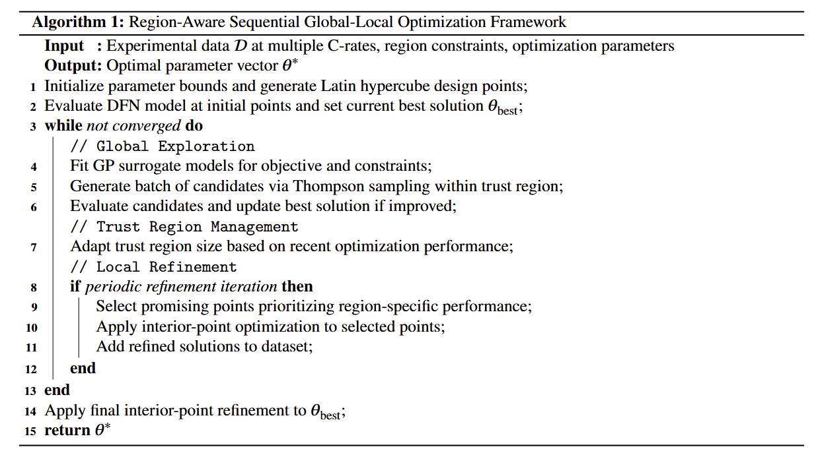
Optimization Framework
Notes:
Theoretical advantages:
High computational efficiency
The algorithm complexity is O (n), requiring only one traversal and simple numerical operations
No need to retrain the model, it can be directly applied to the prediction stage
Compared to sampling methods such as SMOTE, it does not increase training overhead
Good mathematical properties
Maintaining the basic constraint of probability sum of 1
Adaptive adjustment of probability distribution is achieved through threshold mechanism
The design of the amplification factor ensures the rationality of the proportion of probability redistribution

Slide 5
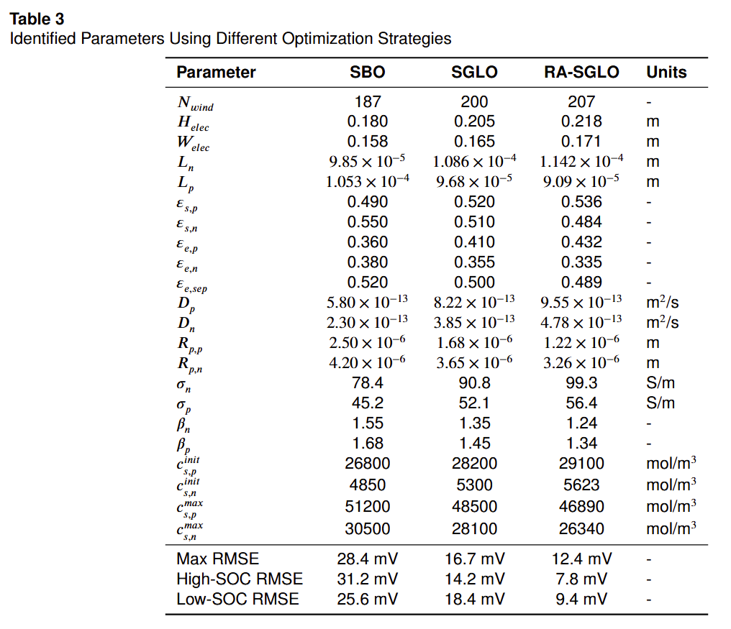
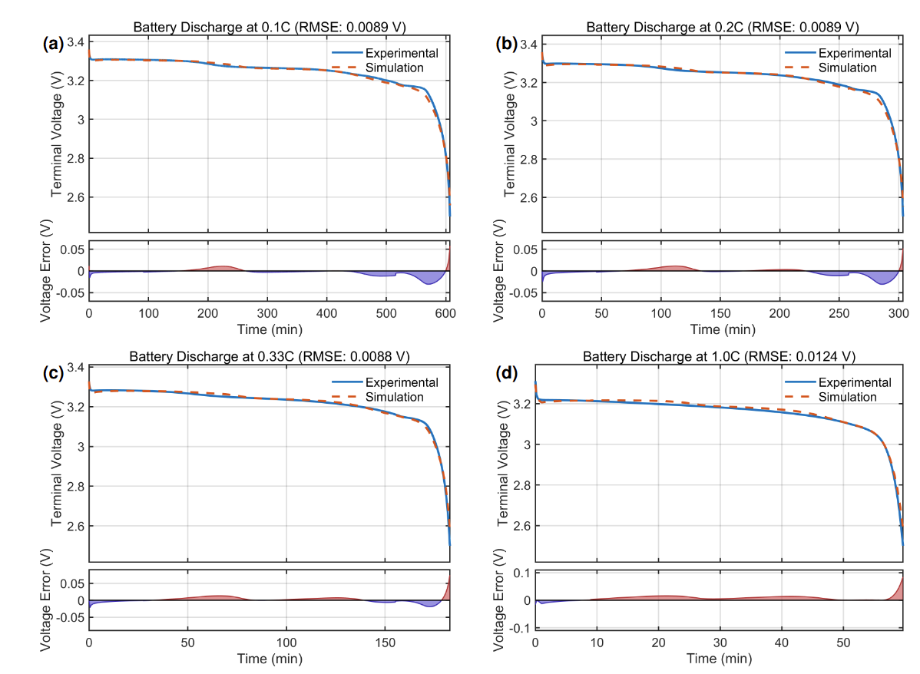
Parameter Identification Results and Multi-Rate Discharge
Table 3 showcases parameter sets obtained via standard Bayesian optimization (SBO), sequential global-local optimization (SGLO), and our region-aware sequential global-local optimization (RA-SGLO).
Notes:
Theoretical advantages:
High computational efficiency
The algorithm complexity is O (n), requiring only one traversal and simple numerical operations
No need to retrain the model, it can be directly applied to the prediction stage
Compared to sampling methods such as SMOTE, it does not increase training overhead
Good mathematical properties
Maintaining the basic constraint of probability sum of 1
Adaptive adjustment of probability distribution is achieved through threshold mechanism
The design of the amplification factor ensures the rationality of the proportion of probability redistribution

Slide 6
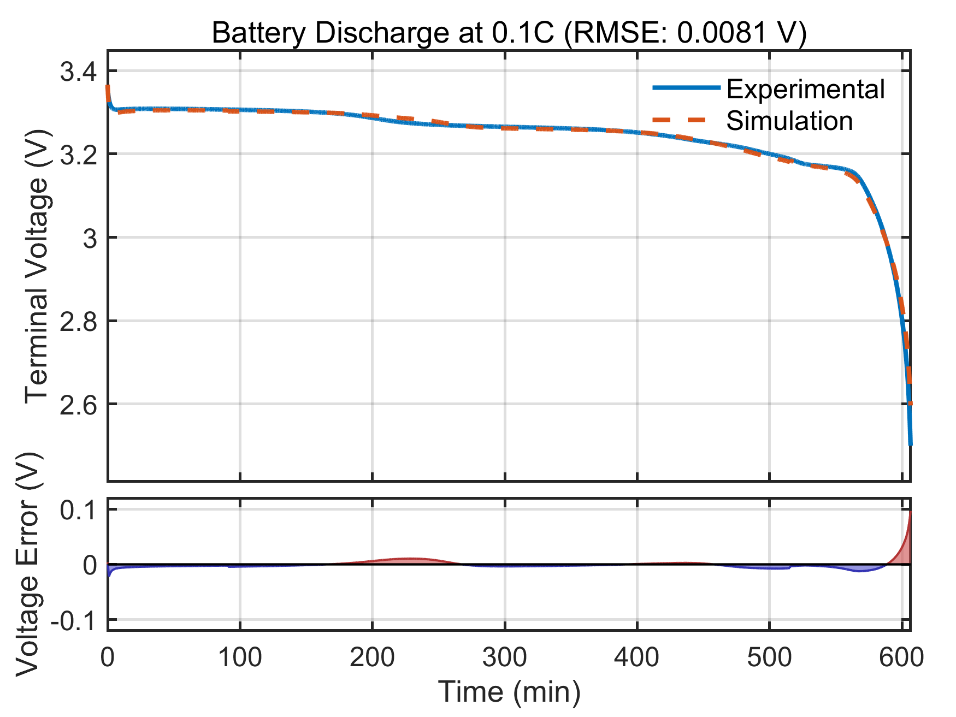
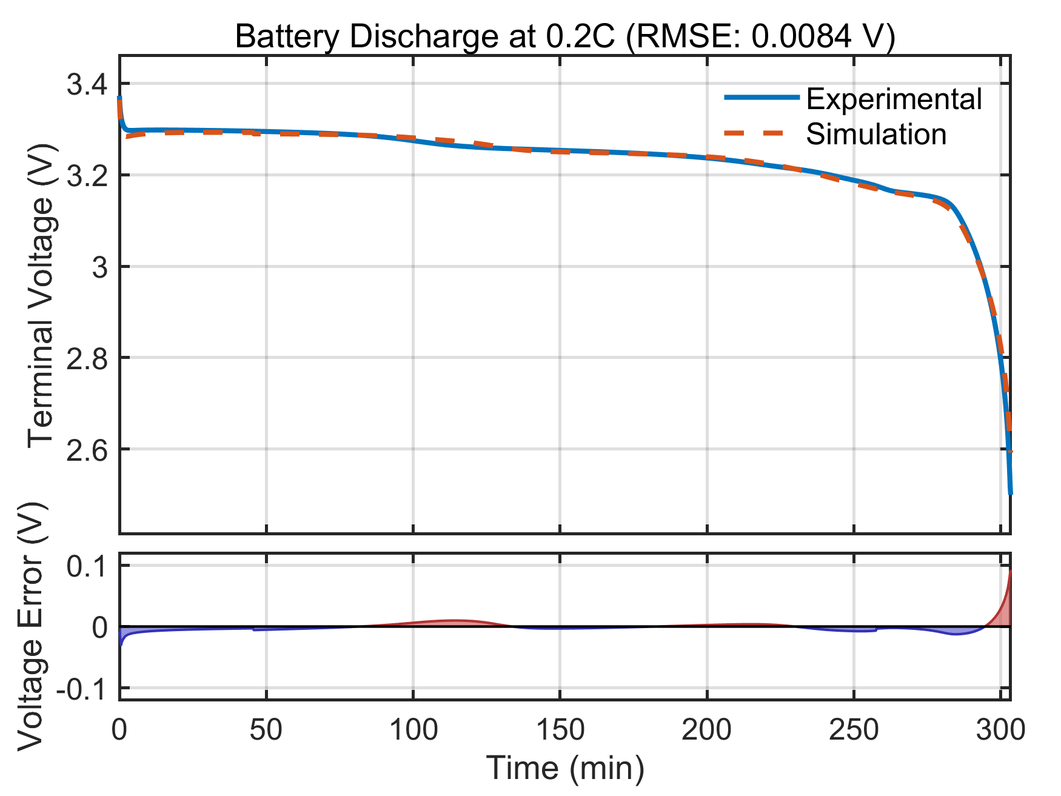
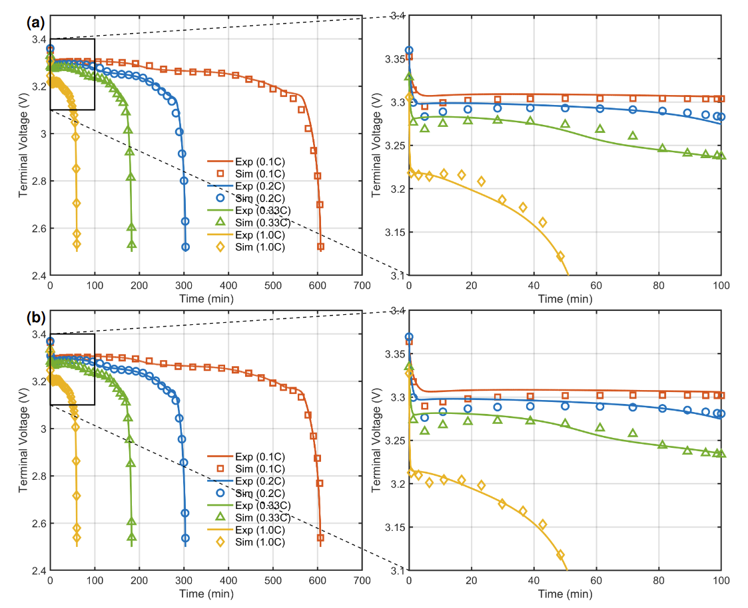
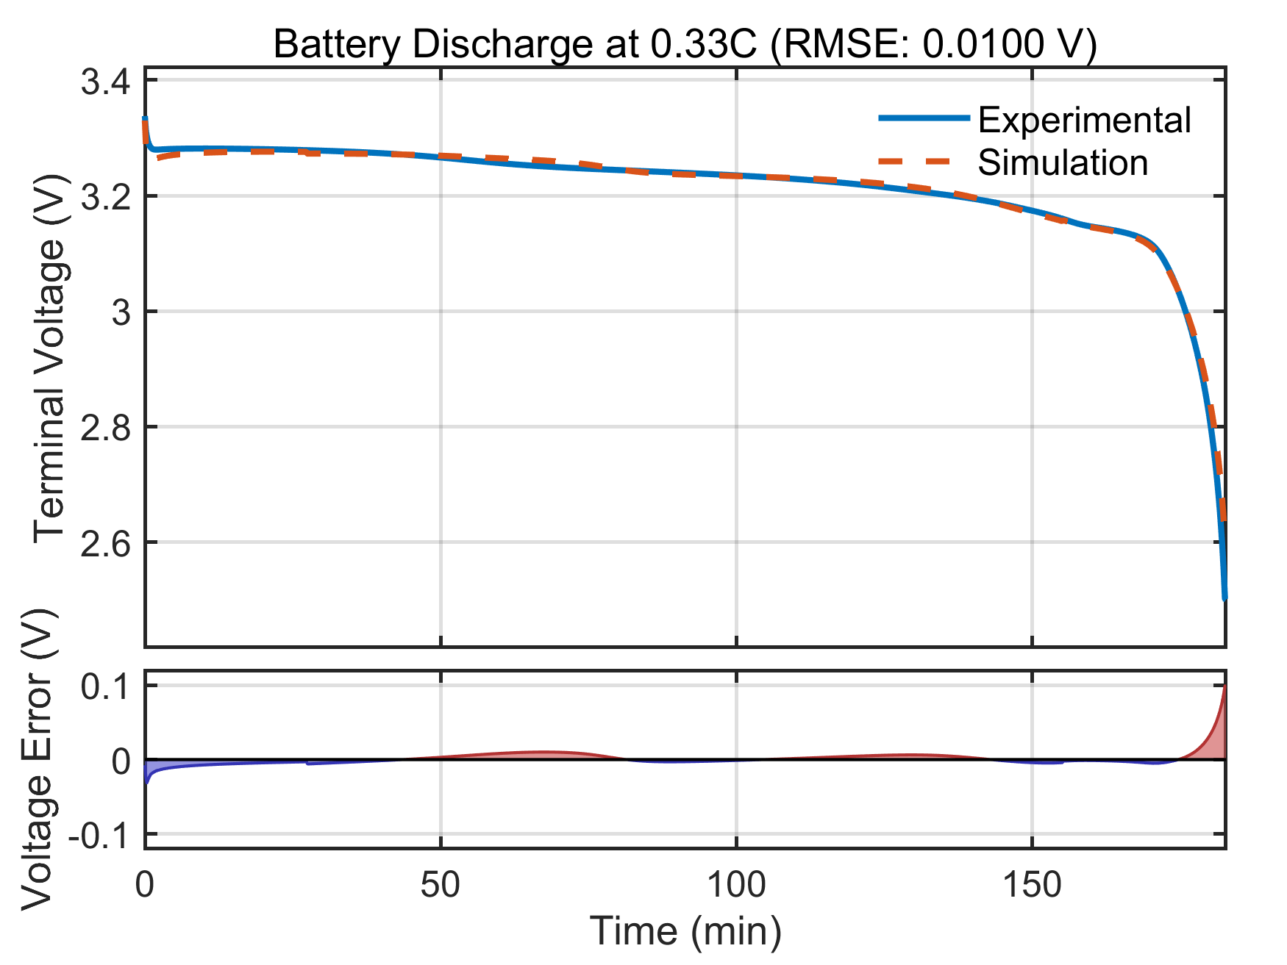
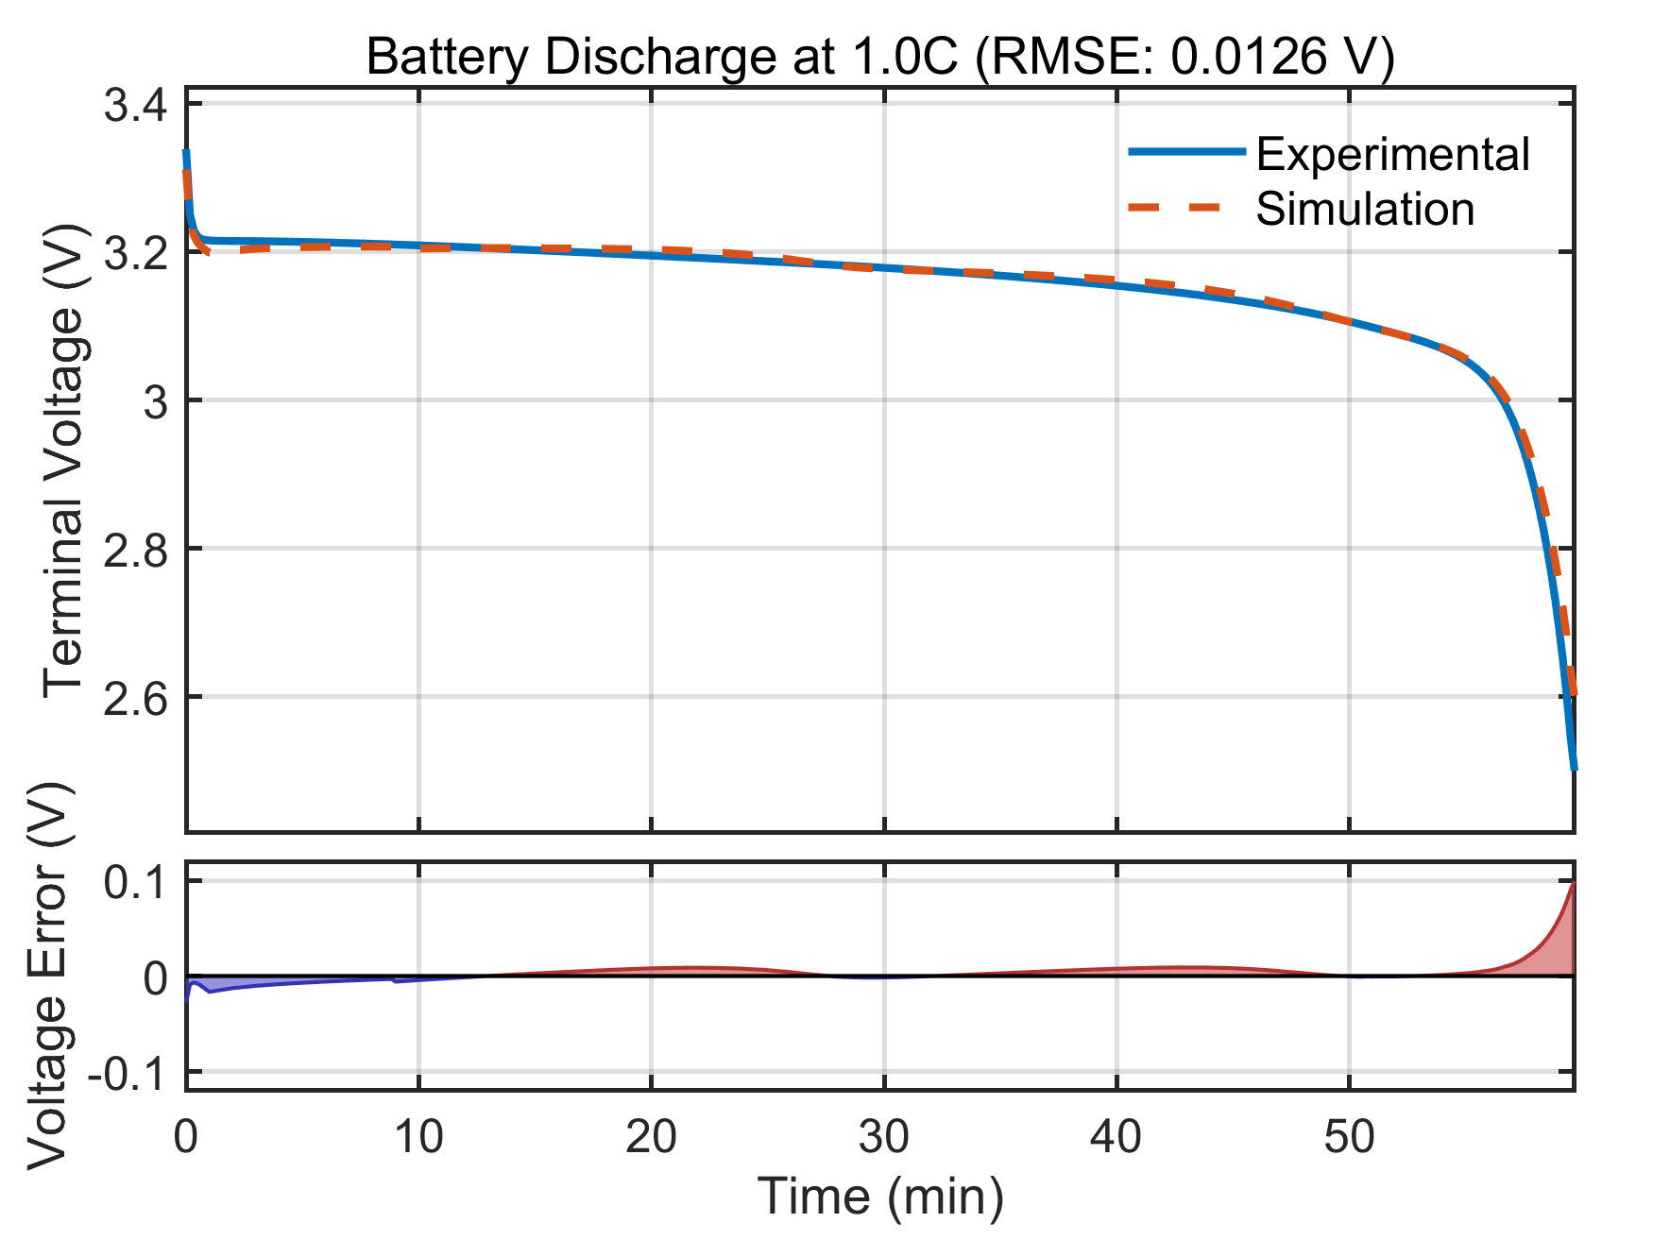
Cross-Cell Validation
Adaptability of the proposed algorithm to different battery discharge behaviors. Parameters for each batteryare individually calibrated based on measured discharge data due to electrochemical variations.
Notes:
Theoretical advantages:
High computational efficiency
The algorithm complexity is O (n), requiring only one traversal and simple numerical operations
No need to retrain the model, it can be directly applied to the prediction stage
Compared to sampling methods such as SMOTE, it does not increase training overhead
Good mathematical properties
Maintaining the basic constraint of probability sum of 1
Adaptive adjustment of probability distribution is achieved through threshold mechanism
The design of the amplification factor ensures the rationality of the proportion of probability redistribution

Slide 7
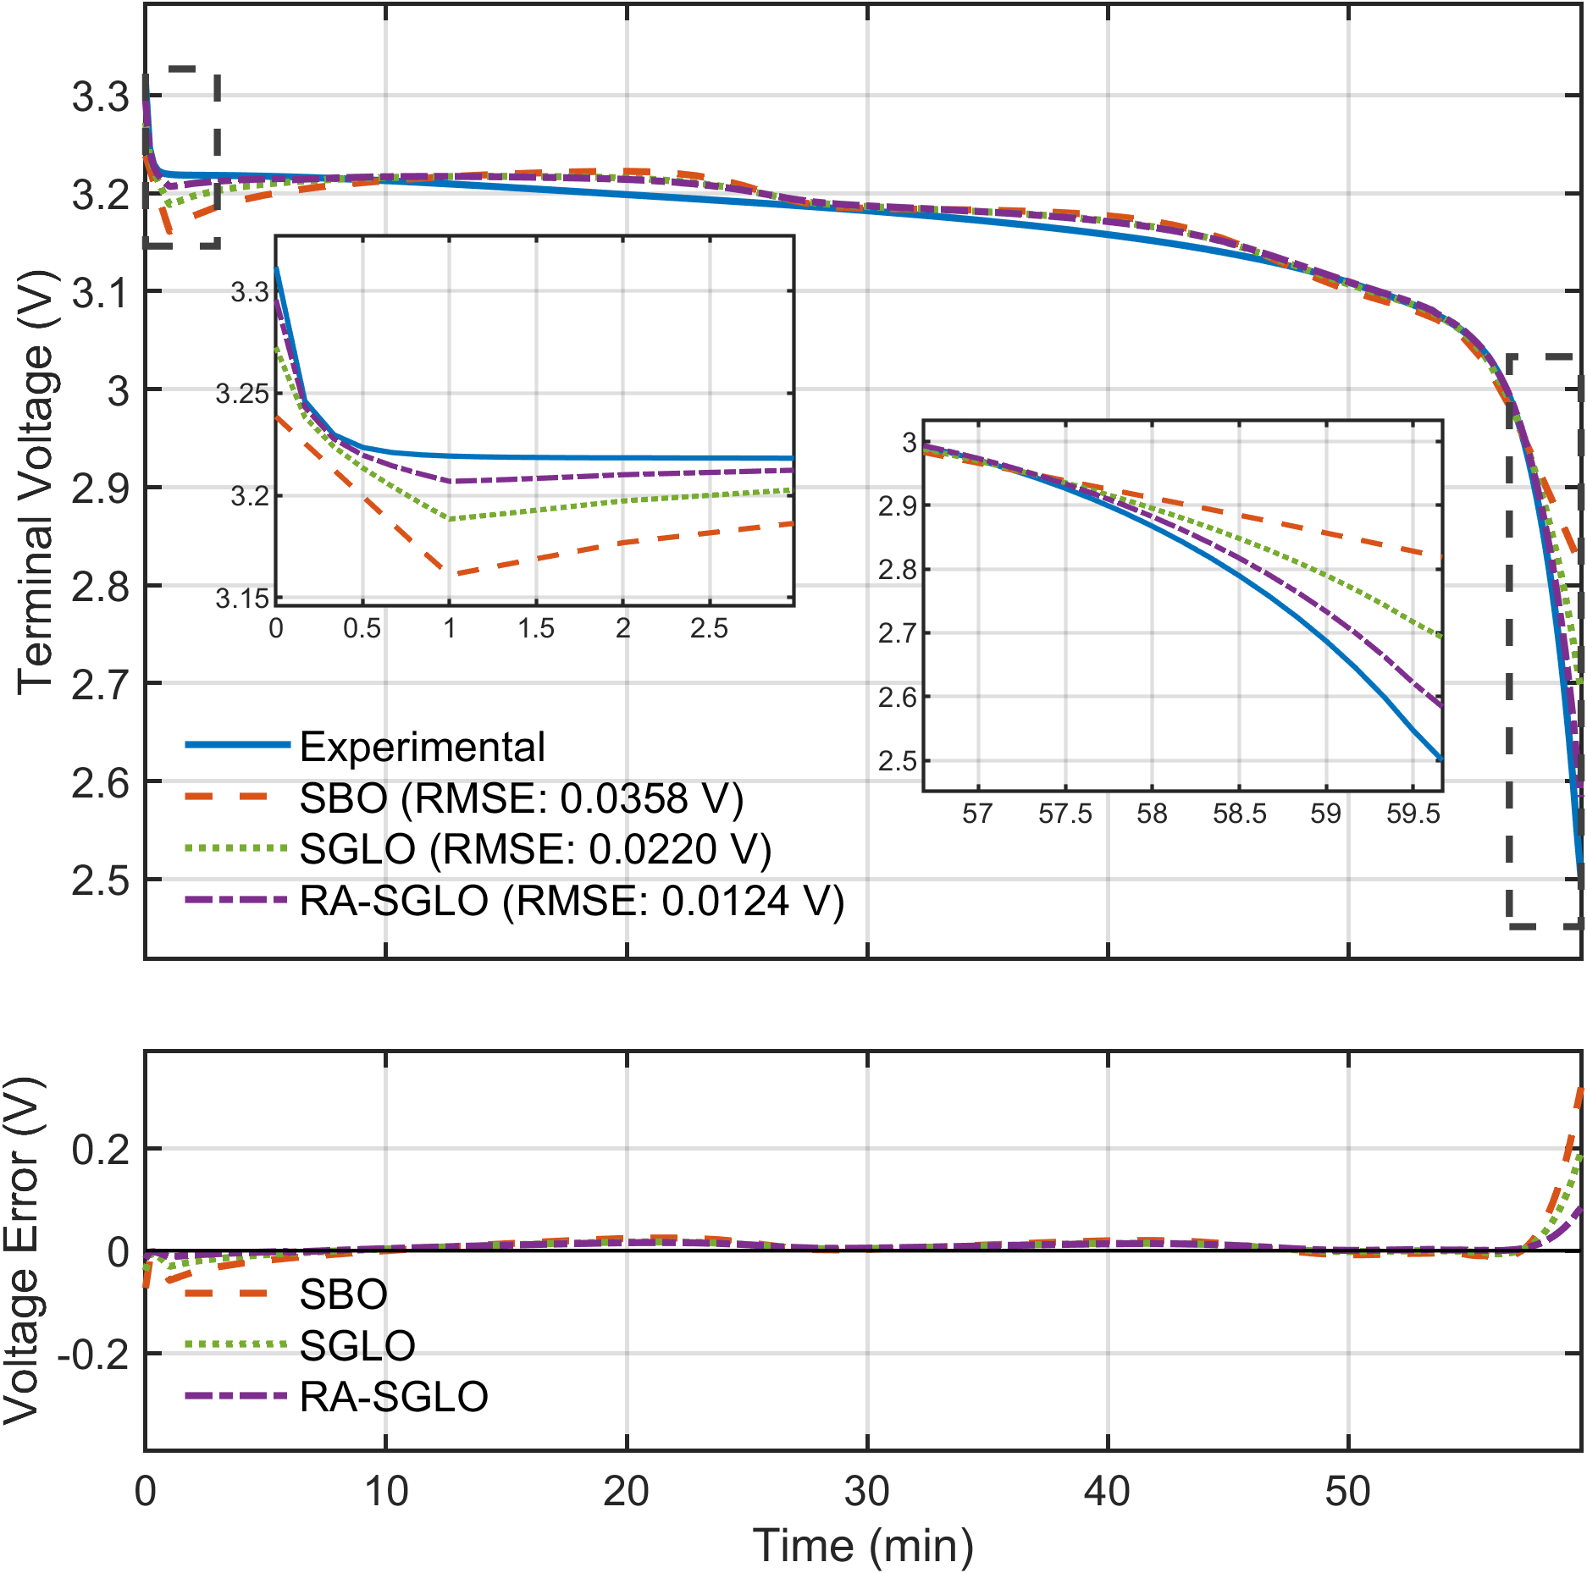
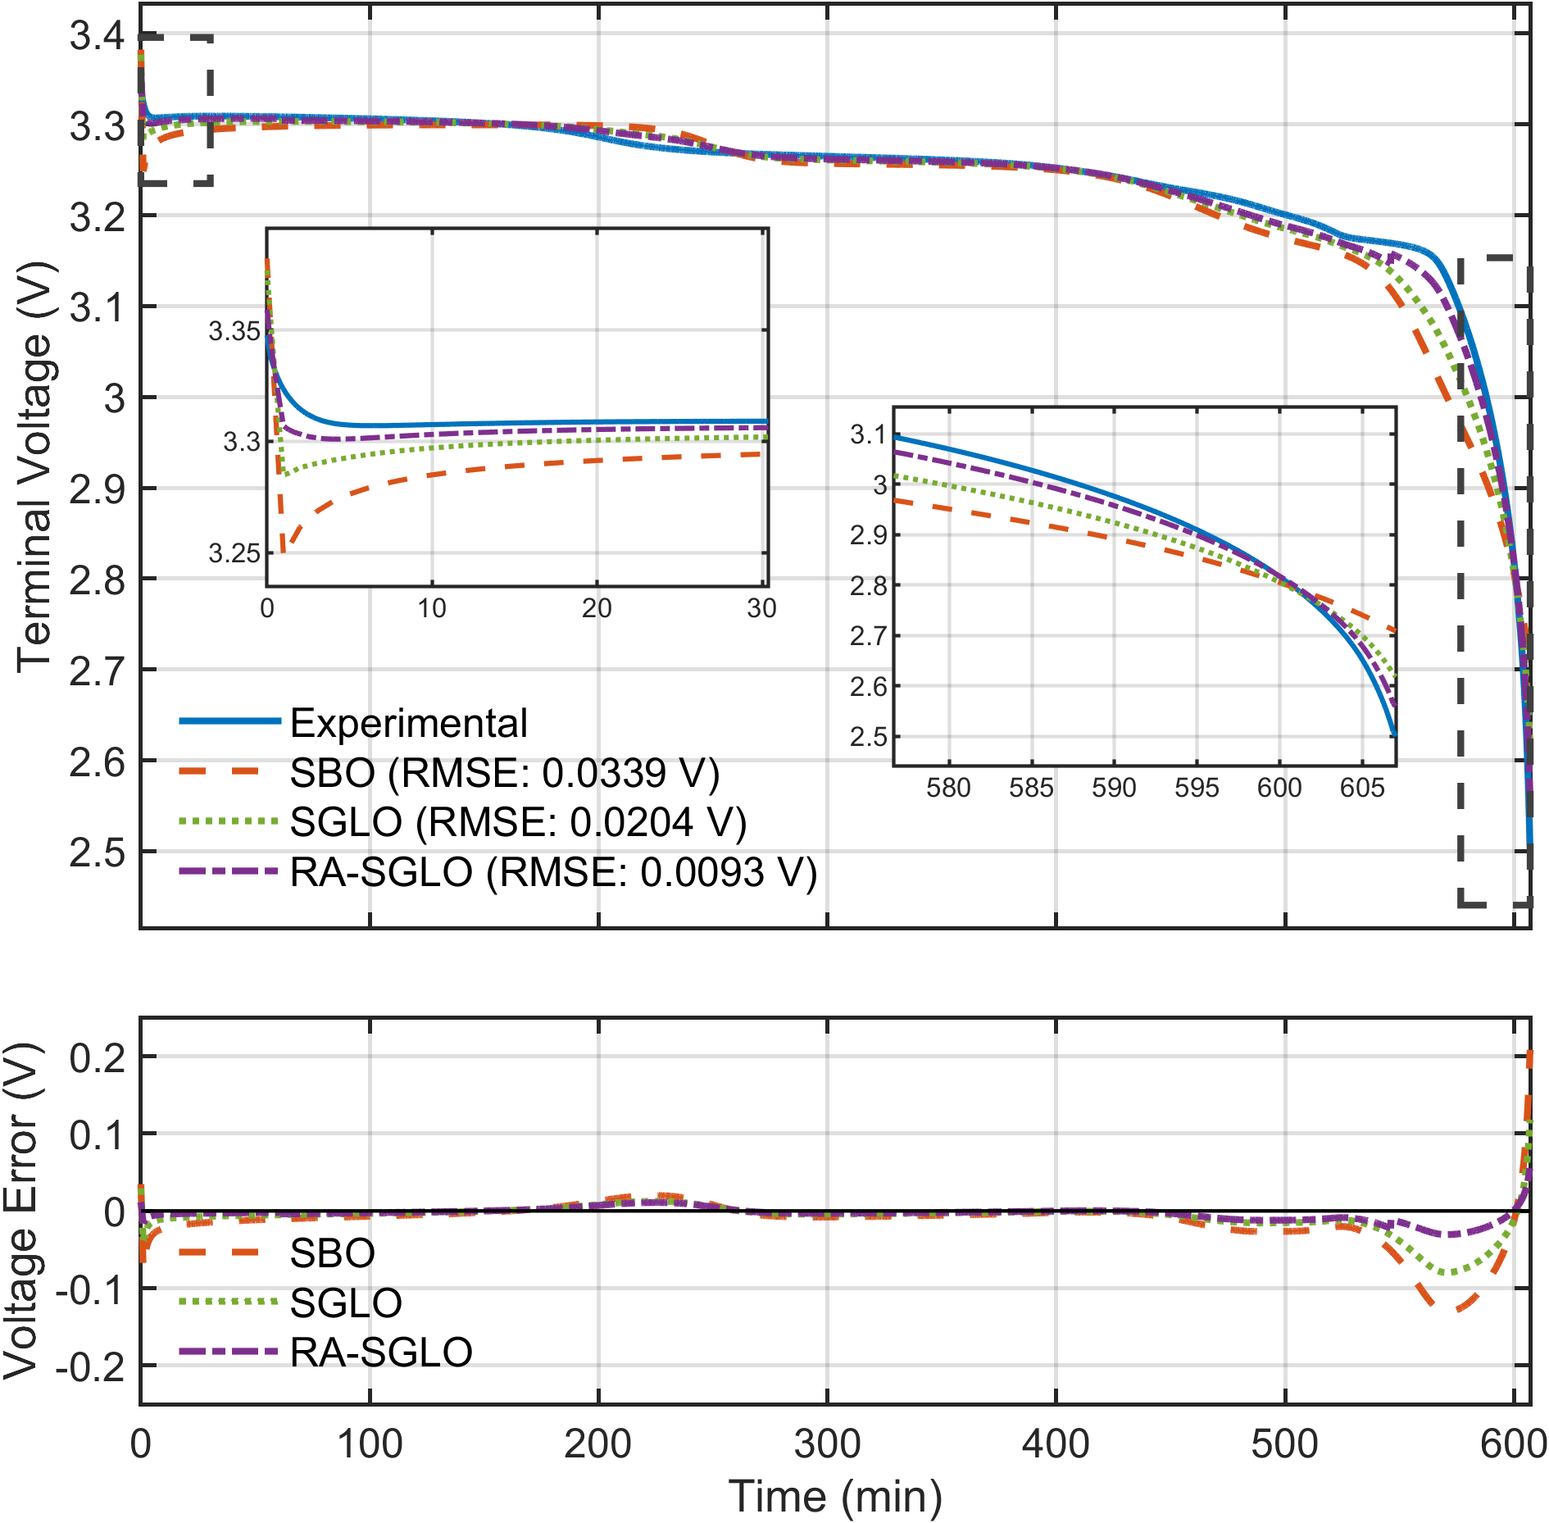
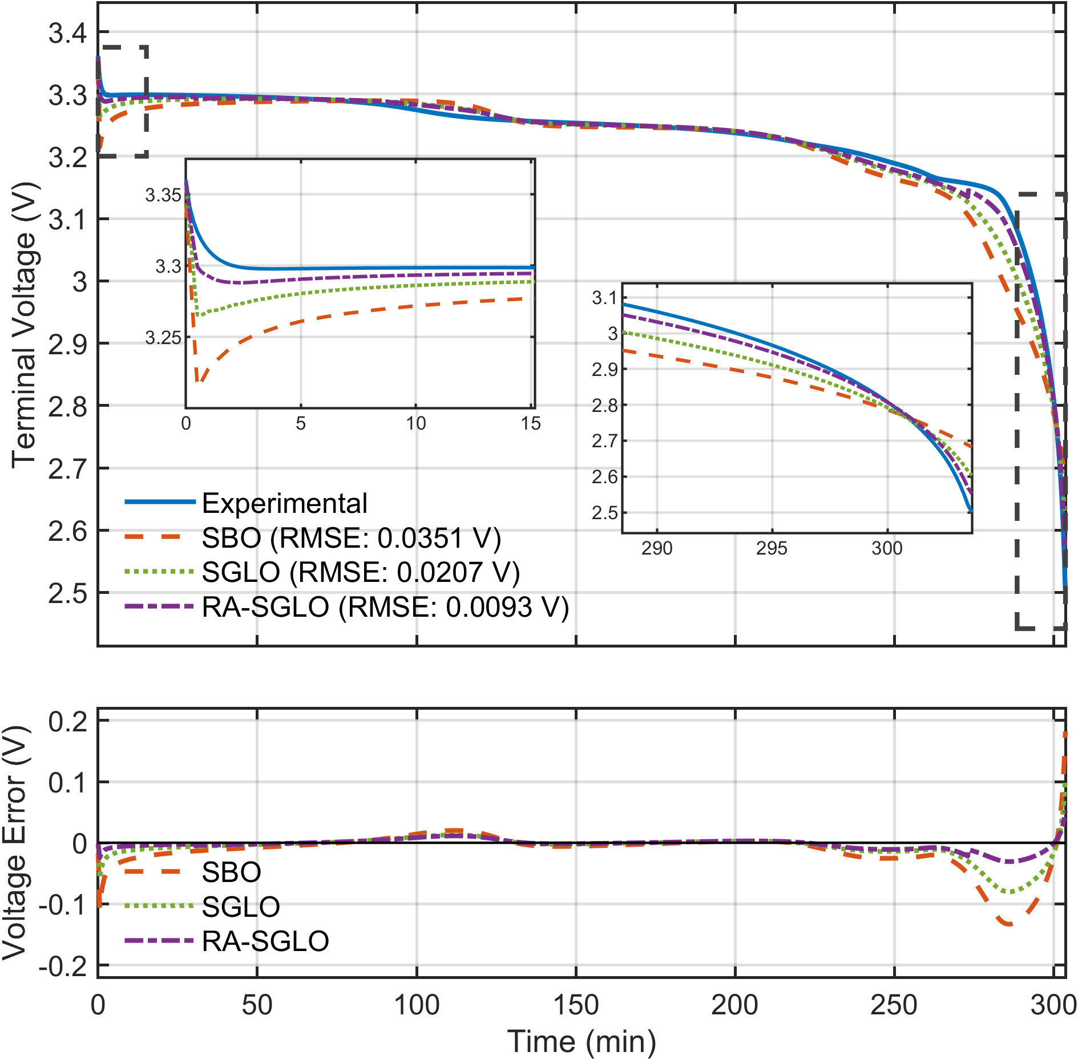
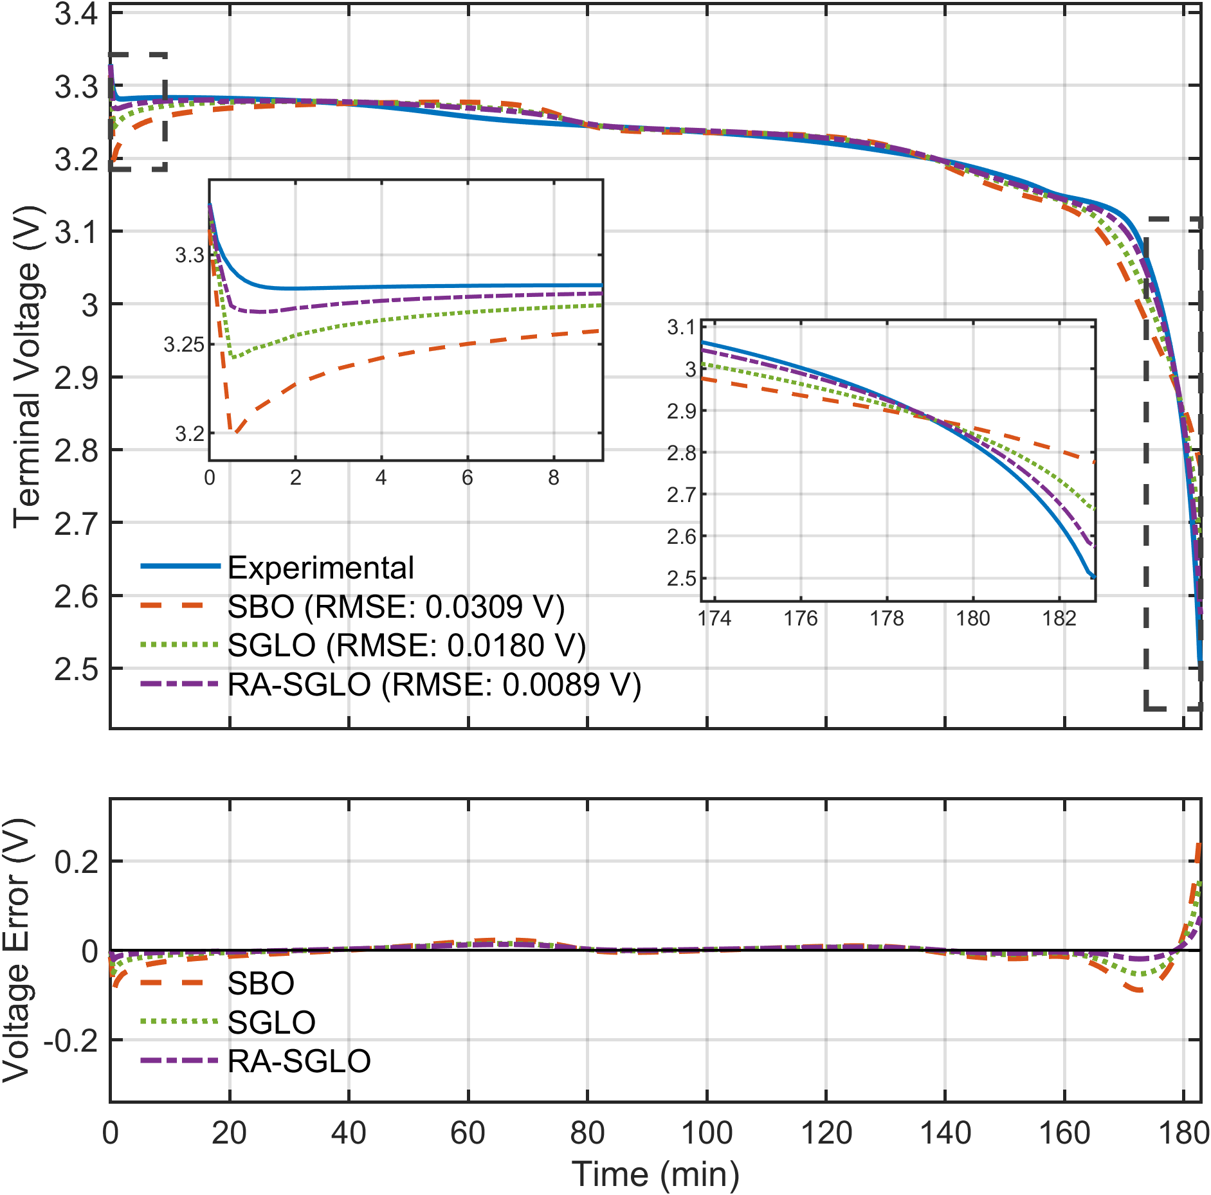
Comparative Analysis of Optimization Strategies
(a)
(b)
(c)
(d)
Comparative analysis of optimization strategies. (a) 0.1C. (b) 0.2C. (c) 0.33C. (d) 1C.
Notes:
Theoretical advantages:
High computational efficiency
The algorithm complexity is O (n), requiring only one traversal and simple numerical operations
No need to retrain the model, it can be directly applied to the prediction stage
Compared to sampling methods such as SMOTE, it does not increase training overhead
Good mathematical properties
Maintaining the basic constraint of probability sum of 1
Adaptive adjustment of probability distribution is achieved through threshold mechanism
The design of the amplification factor ensures the rationality of the proportion of probability redistribution

Slide 8
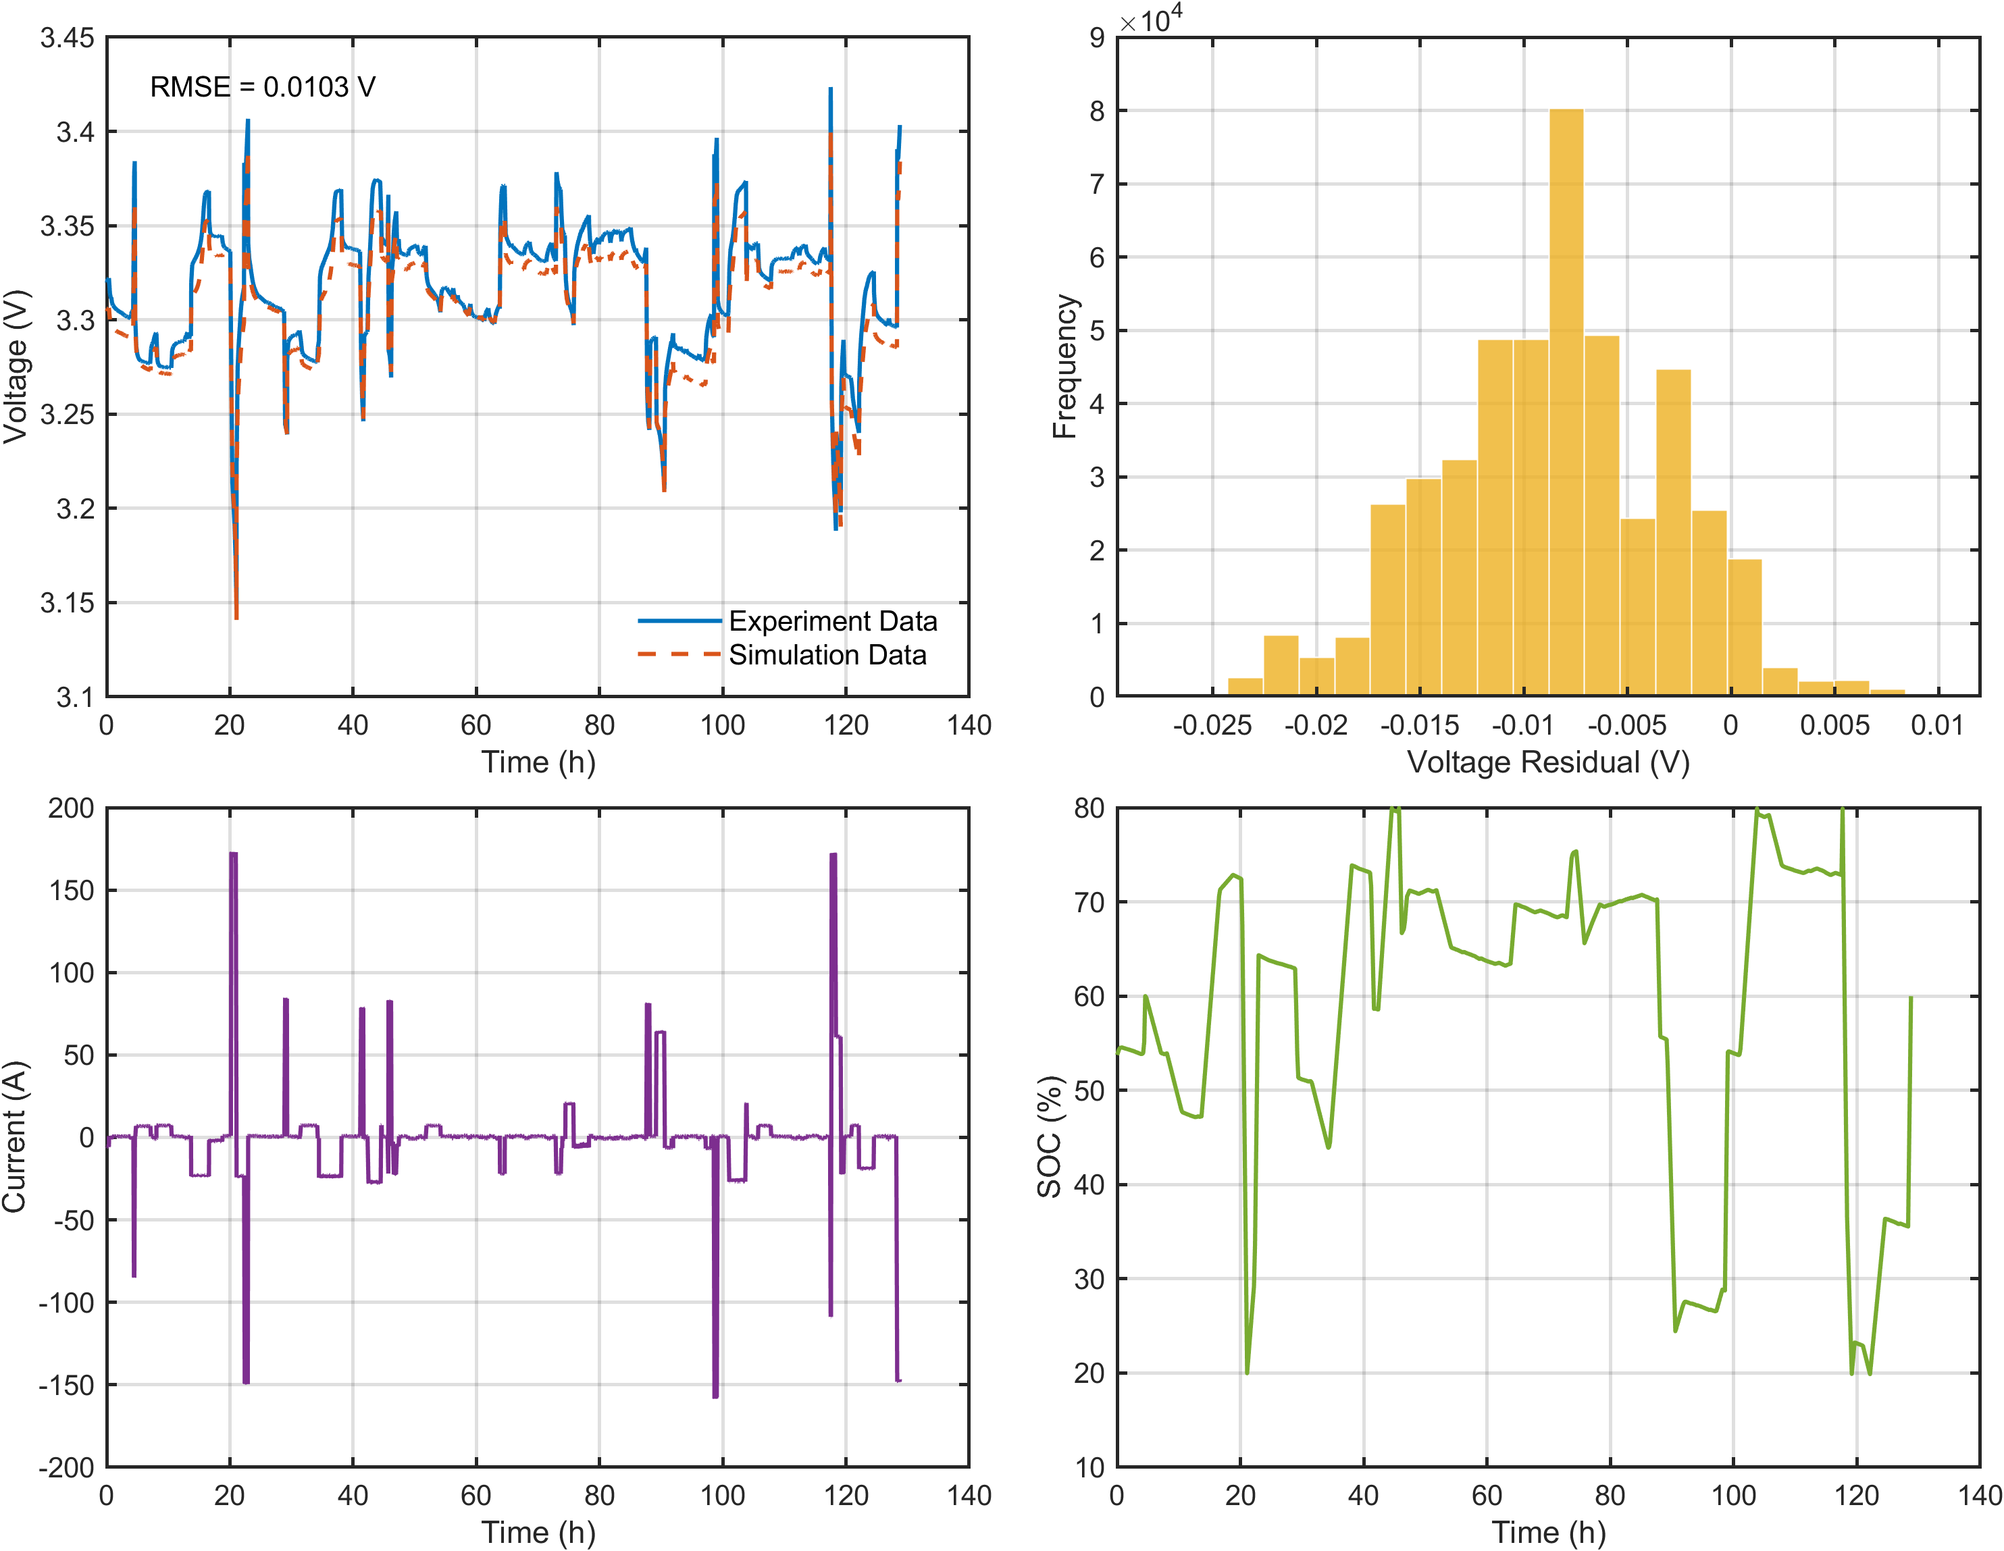
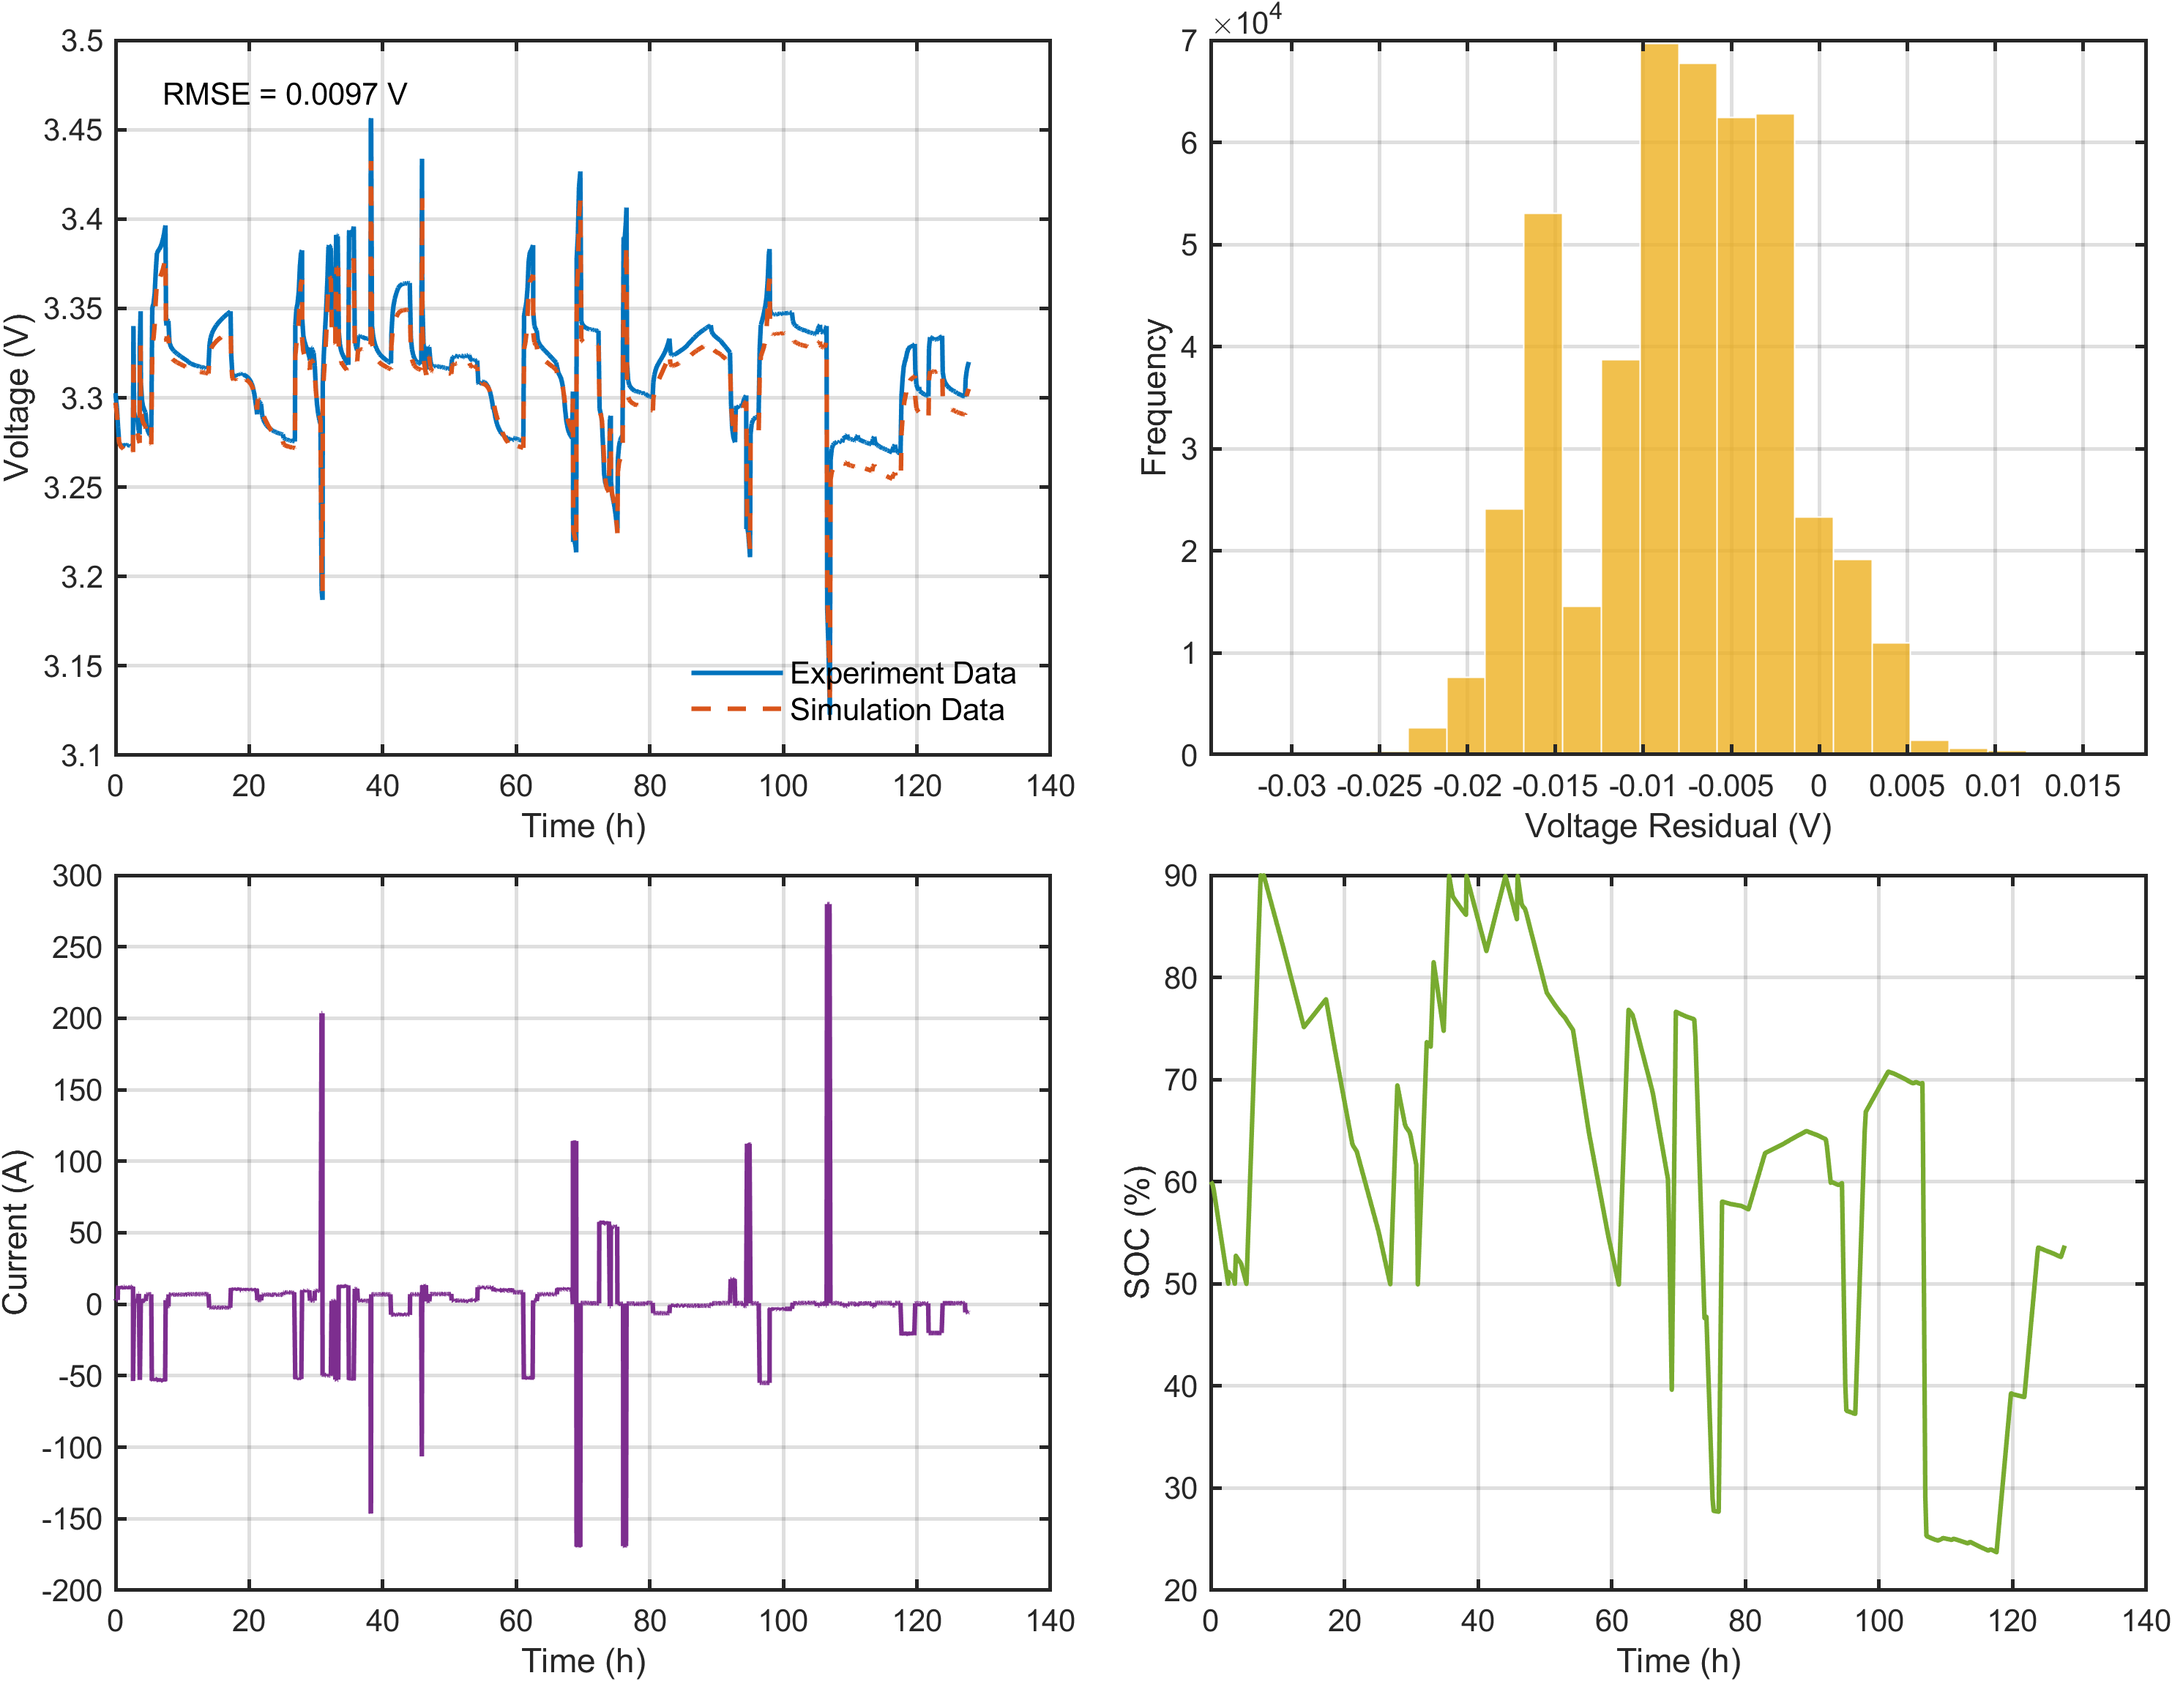
Model Validation Under Random Current Profiles
(a)
(b)
(a)
(b)
(c)
(d)
(c)
(d)
Model validation under dynamic current profiles. (a) Comparison of measured and simulatedvoltage responses under a dynamic current profile. (b) Error distribution histogram showing deviation between modelpredictions and experimental measurements. (c) Dynamic current profile. (d) SOC of the battery.
Notes:
Theoretical advantages:
High computational efficiency
The algorithm complexity is O (n), requiring only one traversal and simple numerical operations
No need to retrain the model, it can be directly applied to the prediction stage
Compared to sampling methods such as SMOTE, it does not increase training overhead
Good mathematical properties
Maintaining the basic constraint of probability sum of 1
Adaptive adjustment of probability distribution is achieved through threshold mechanism
The design of the amplification factor ensures the rationality of the proportion of probability redistribution

